Slide 1
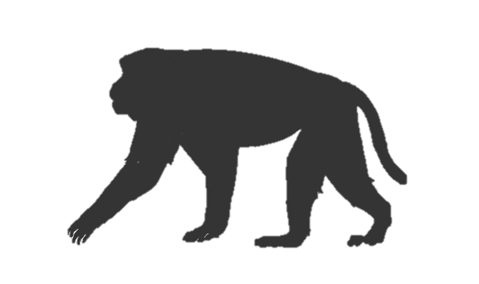

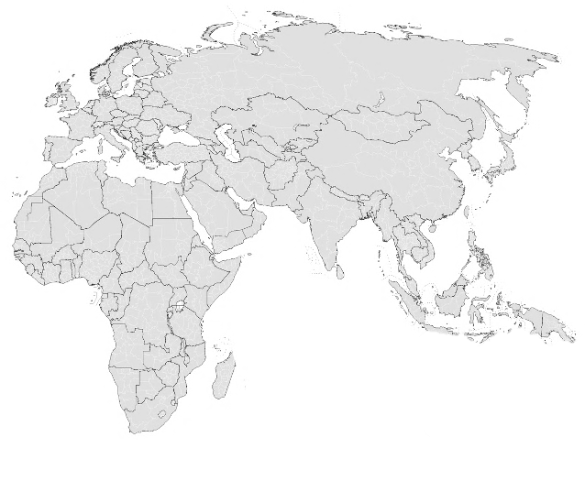
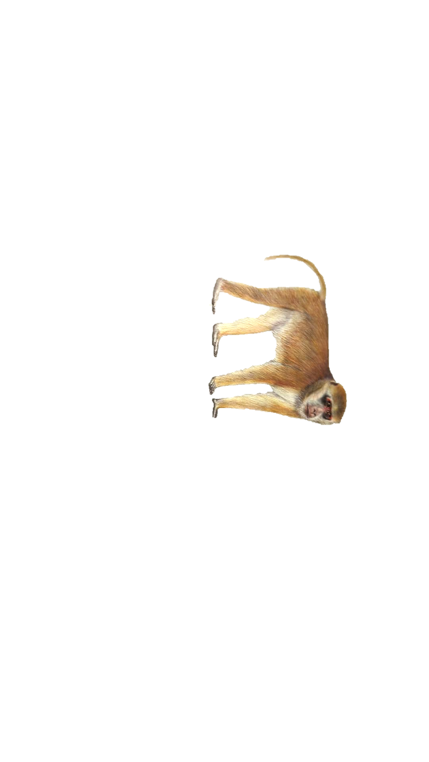
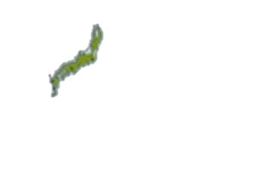


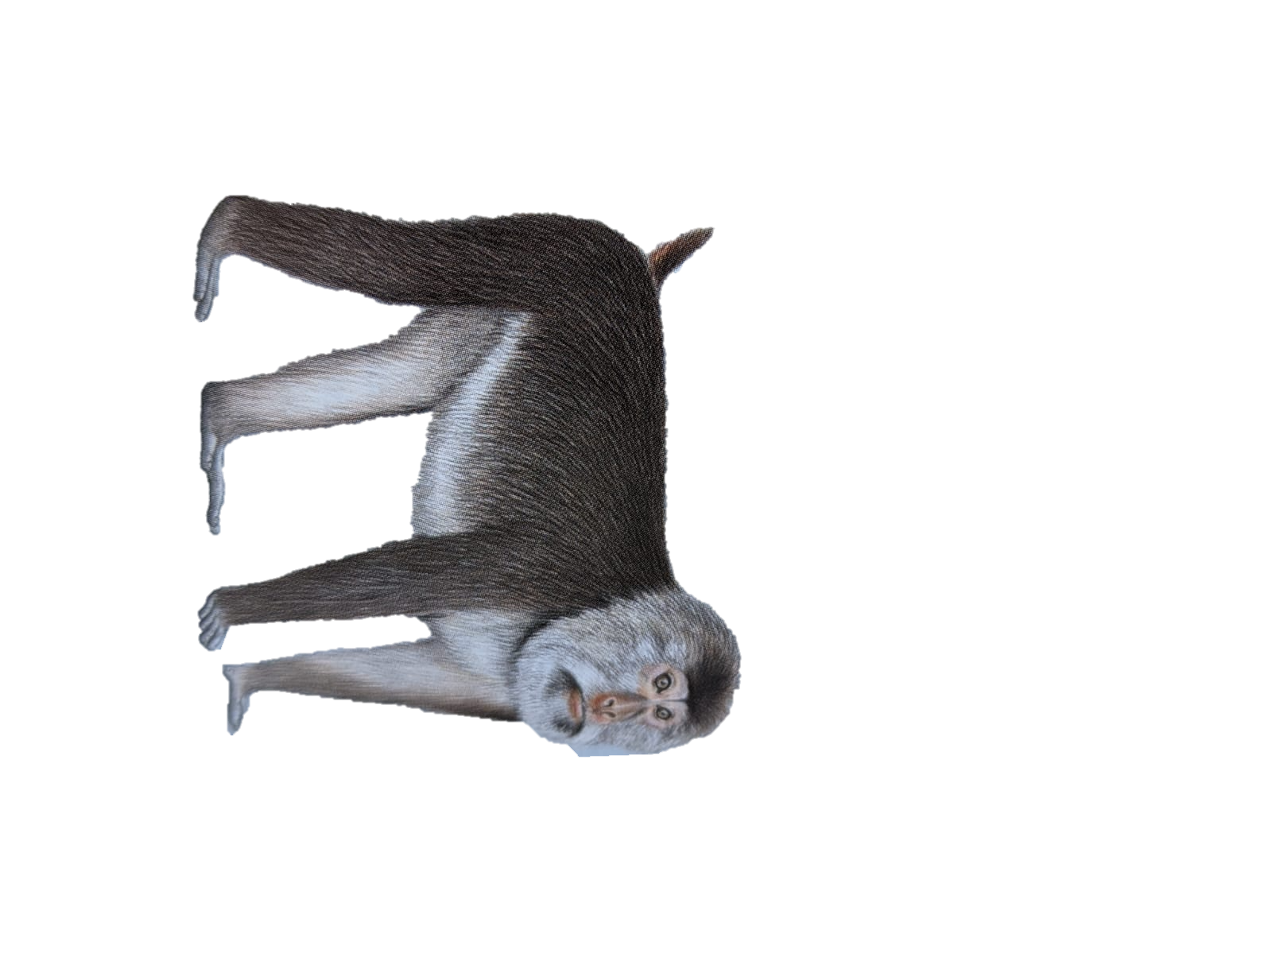



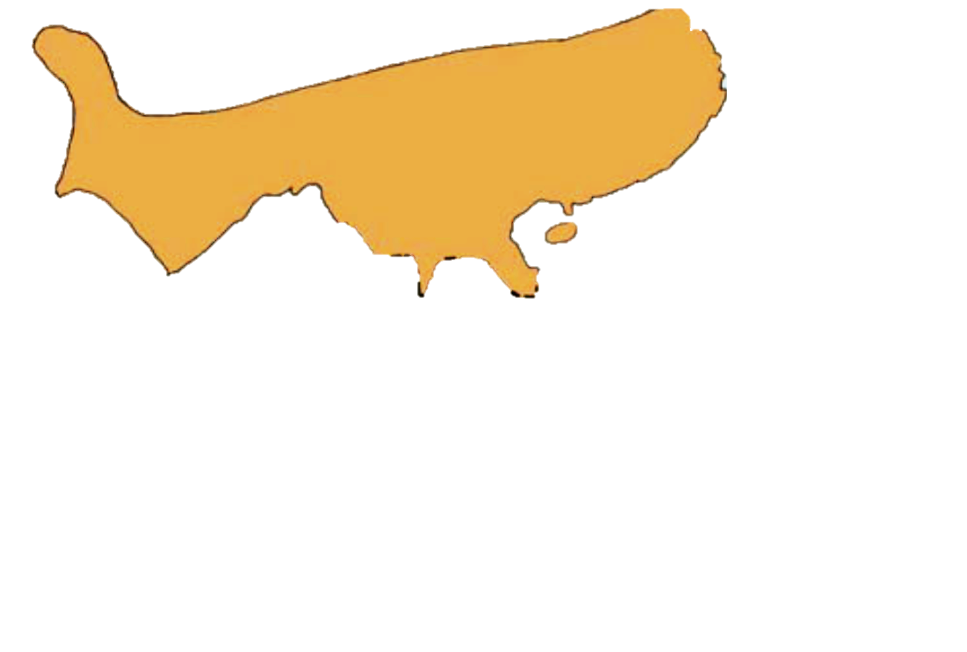
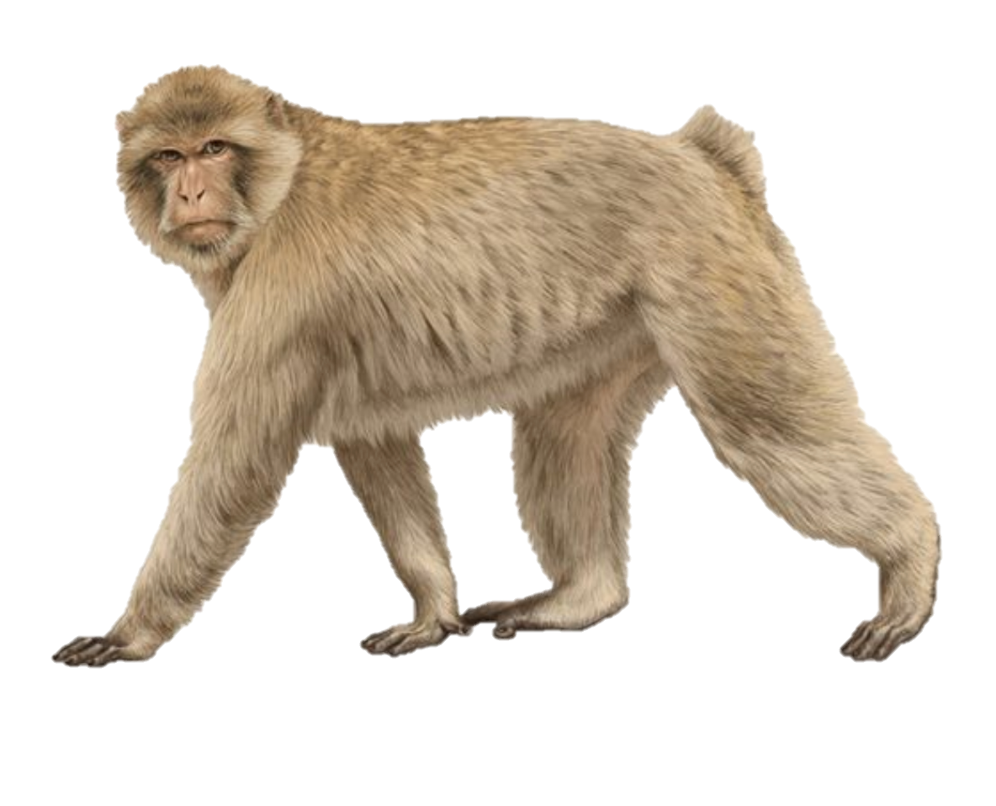
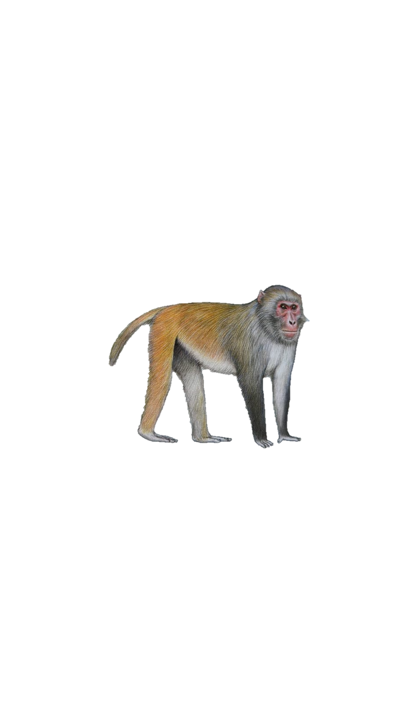



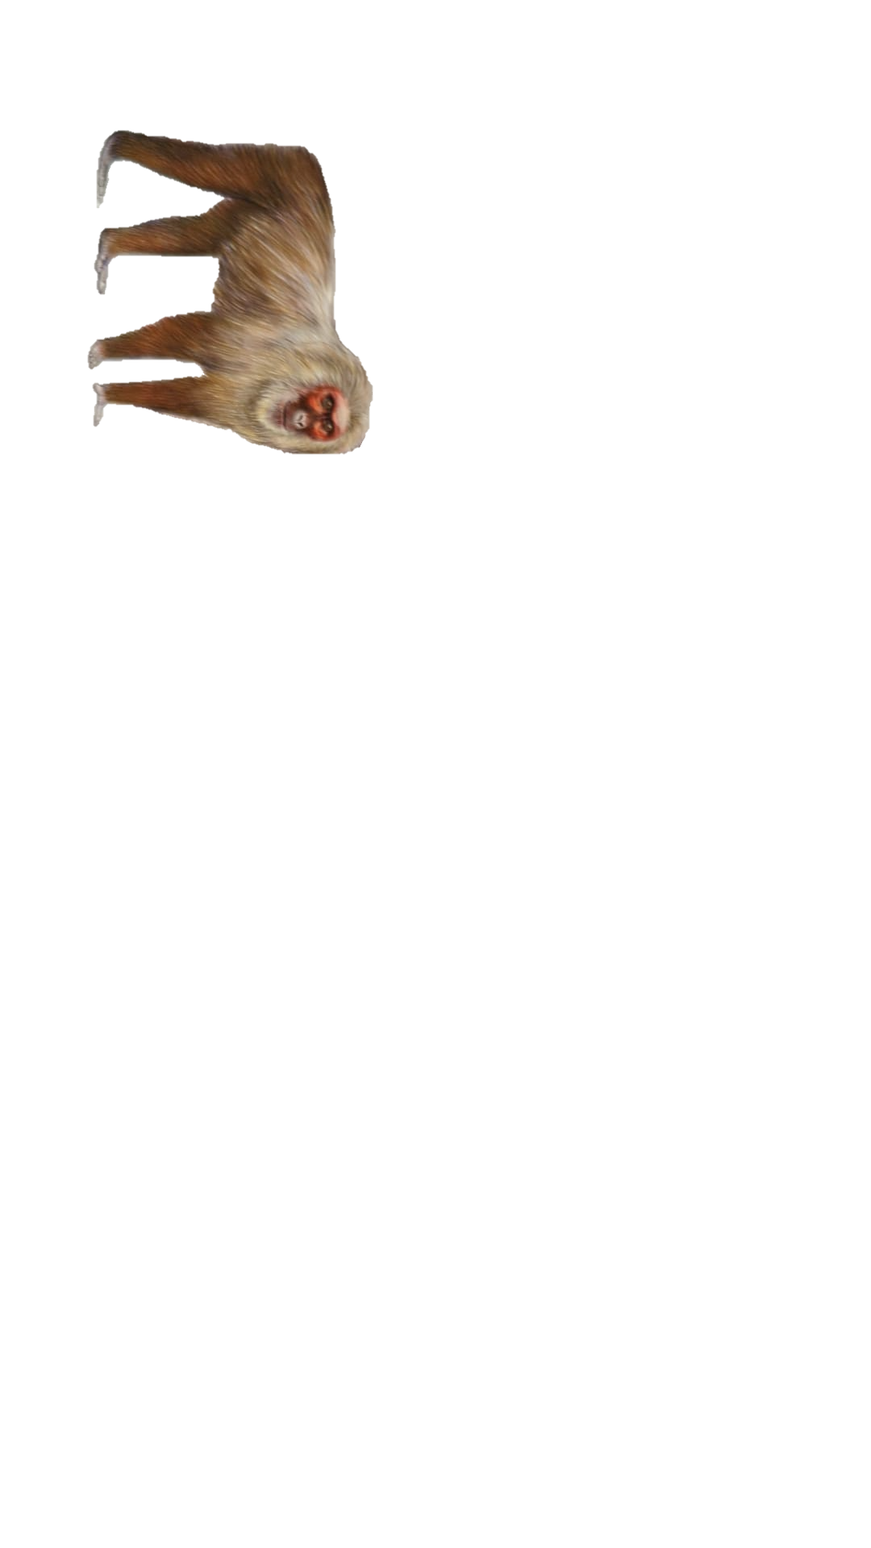
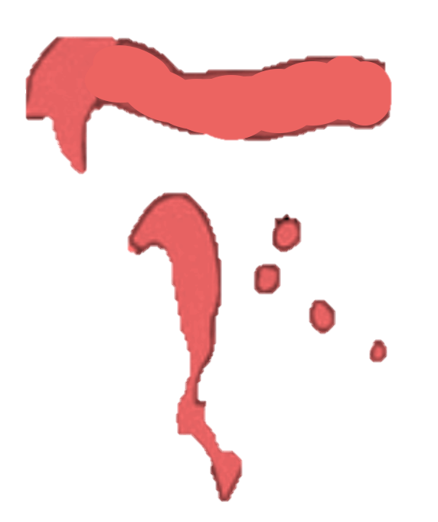

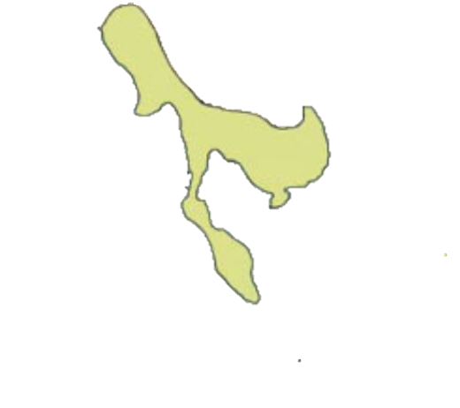
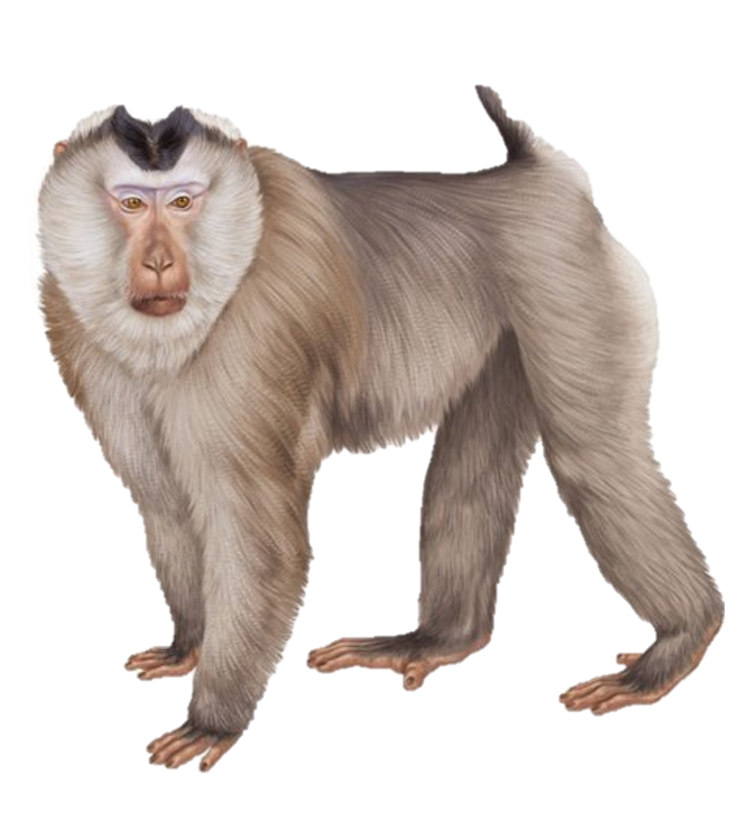
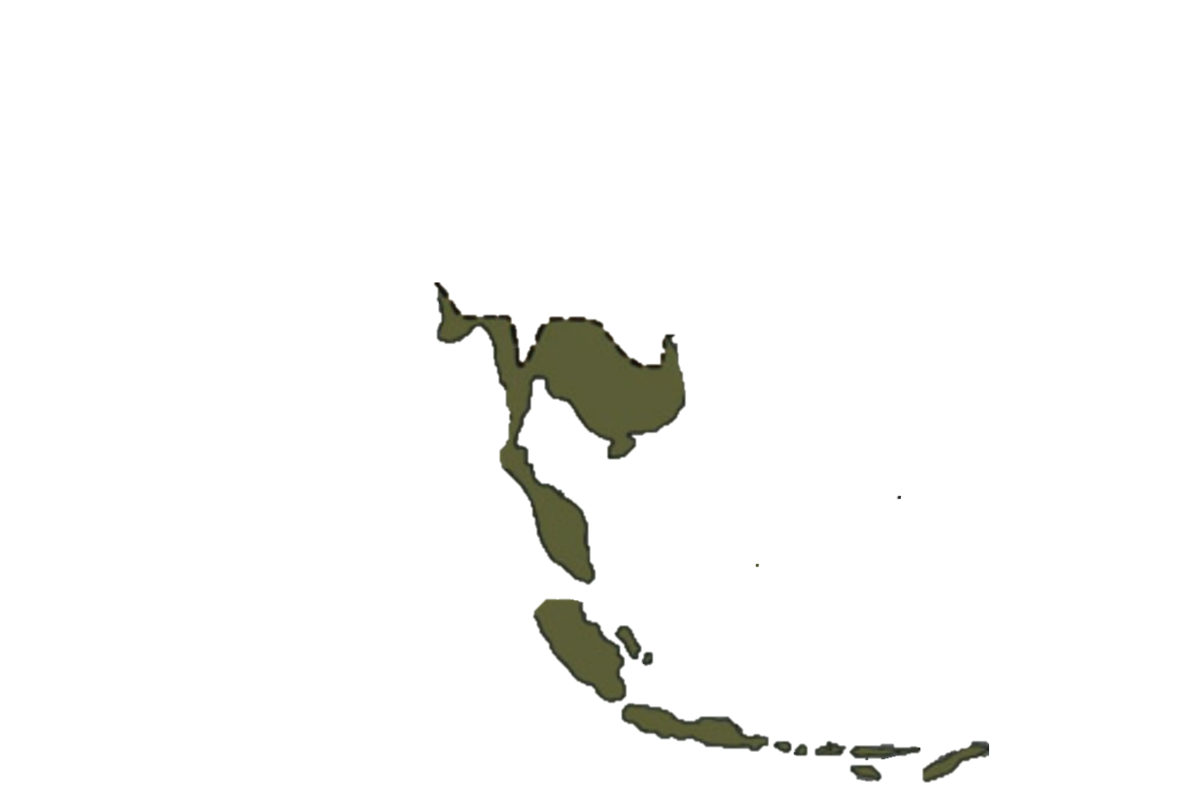
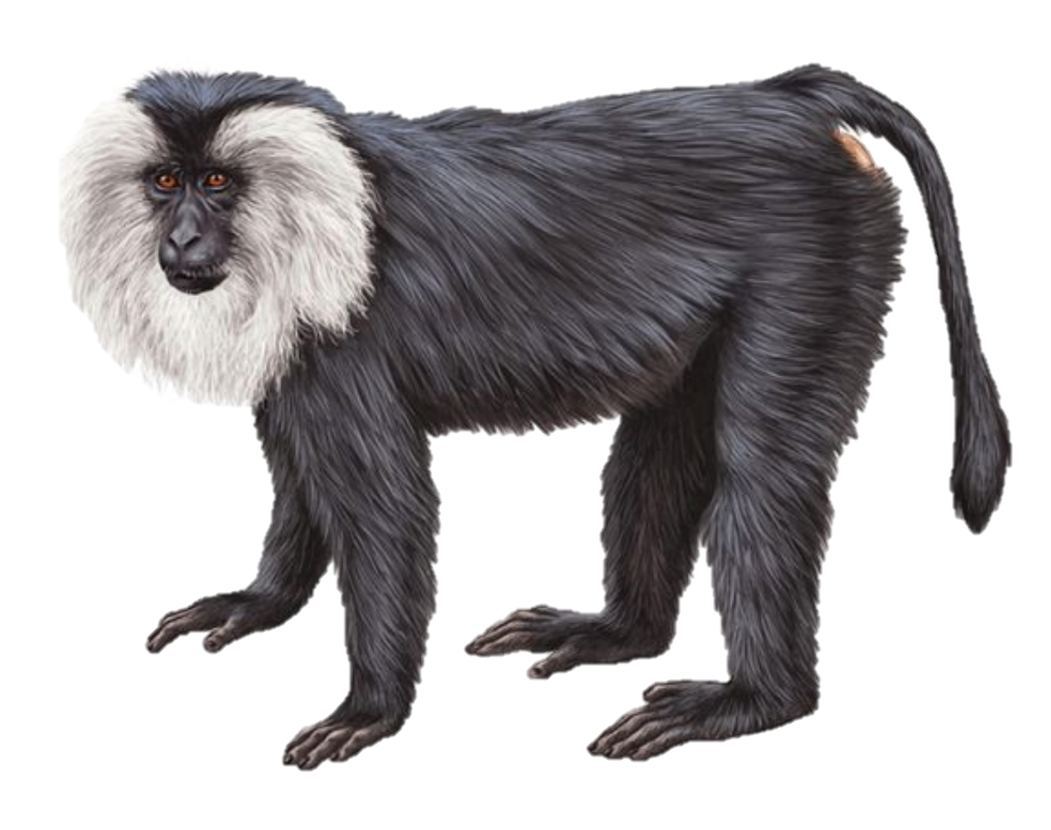
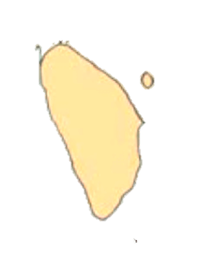
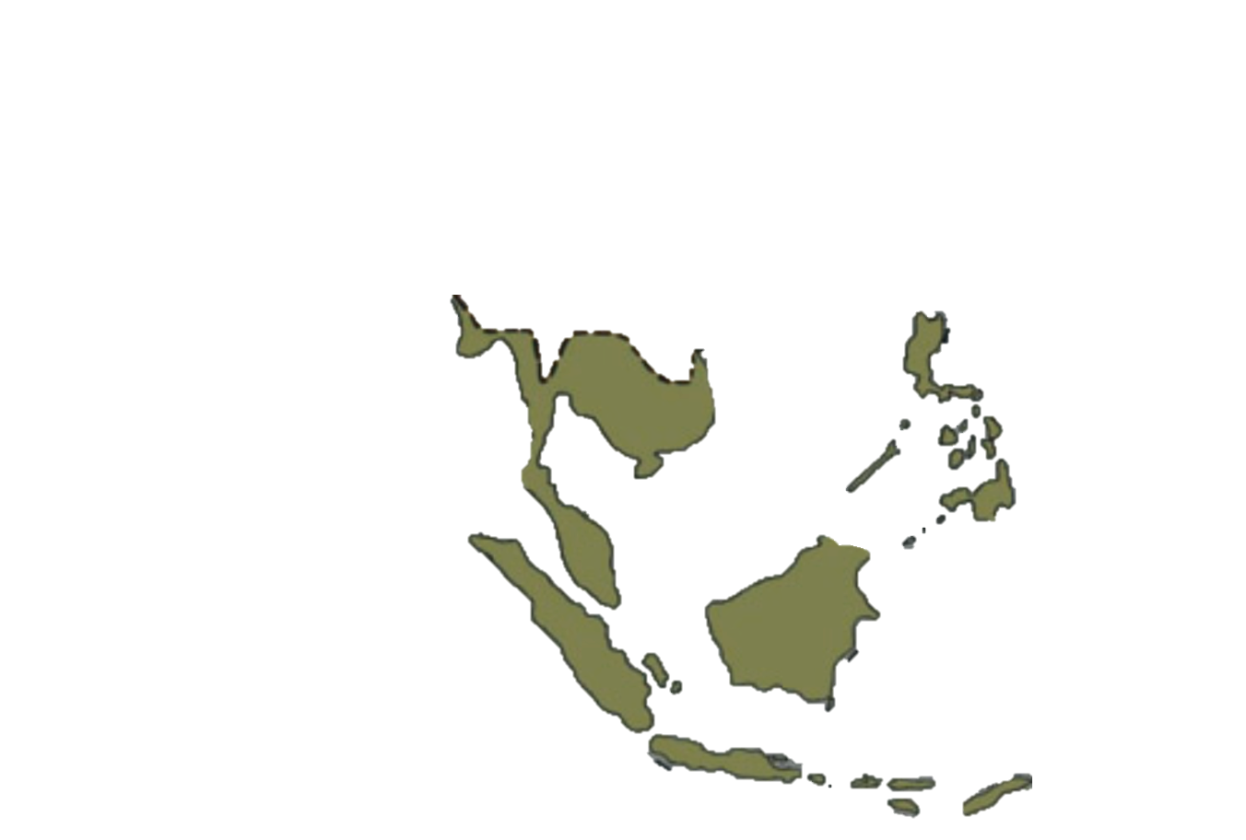




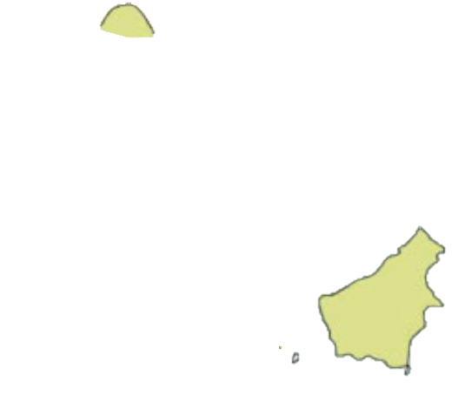
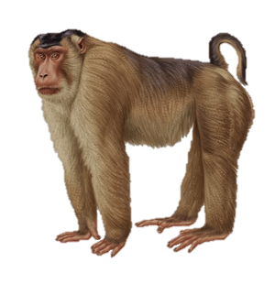
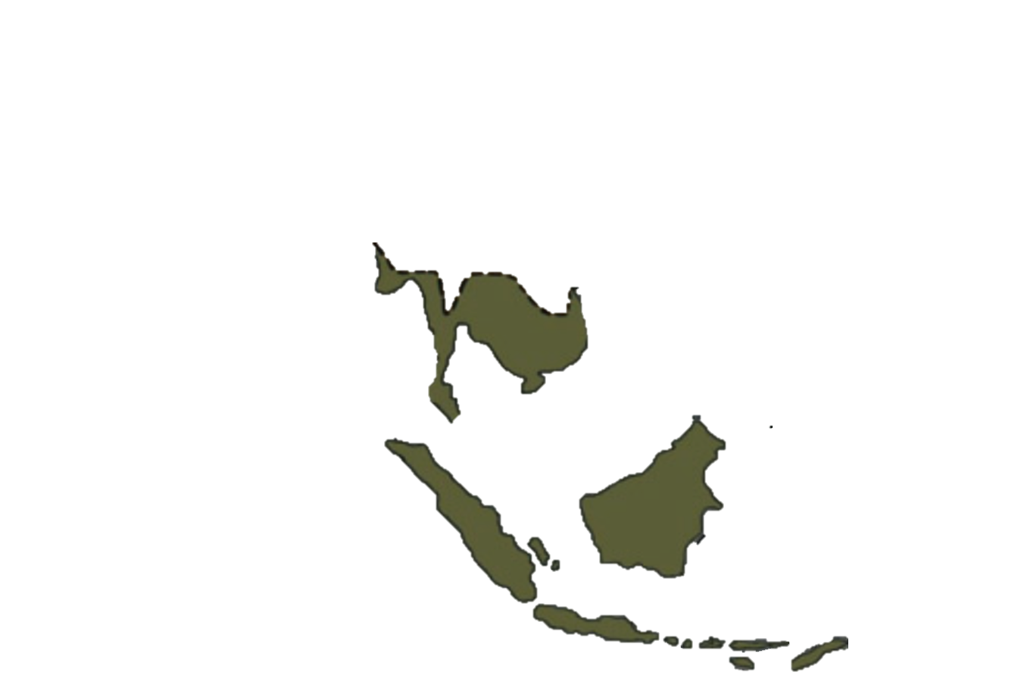
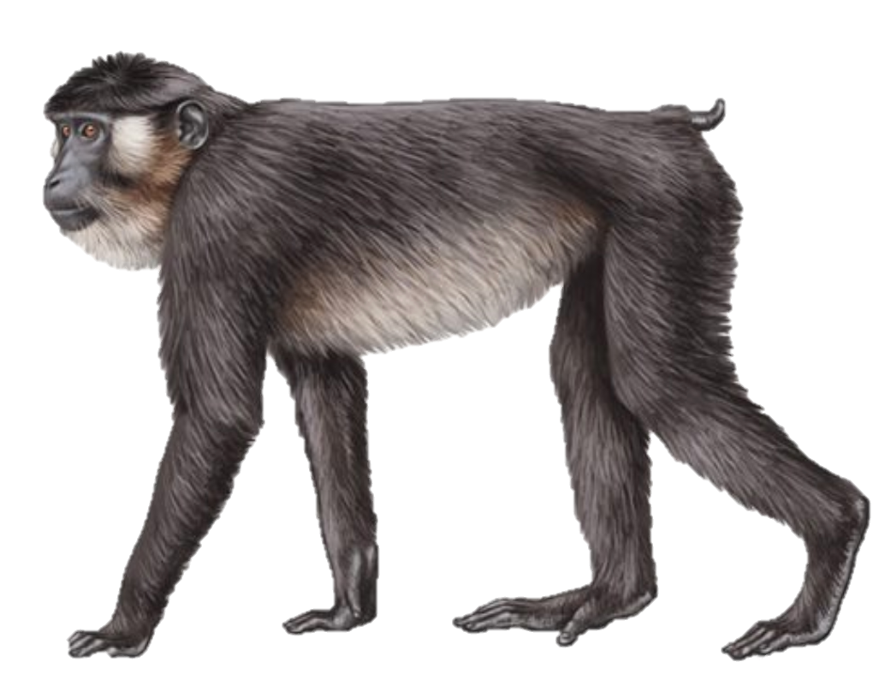
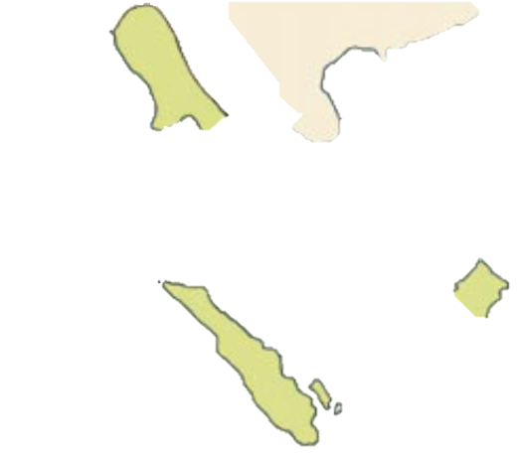

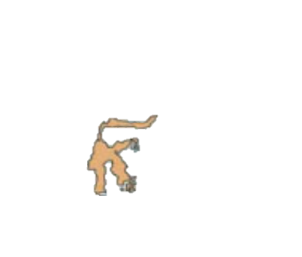
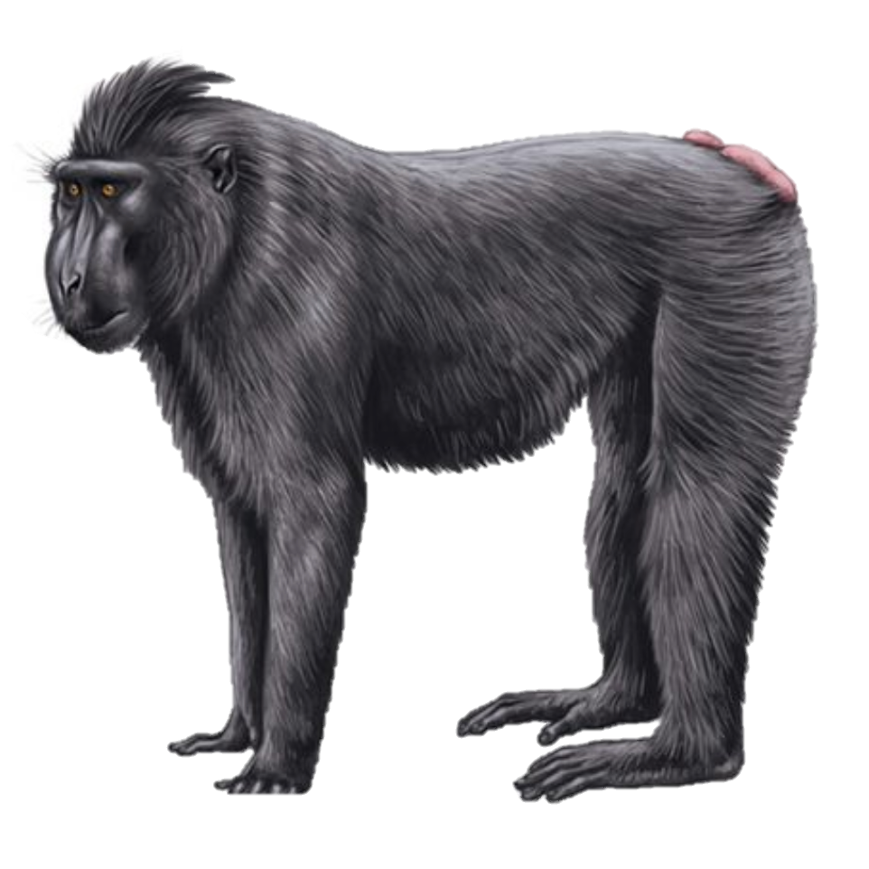
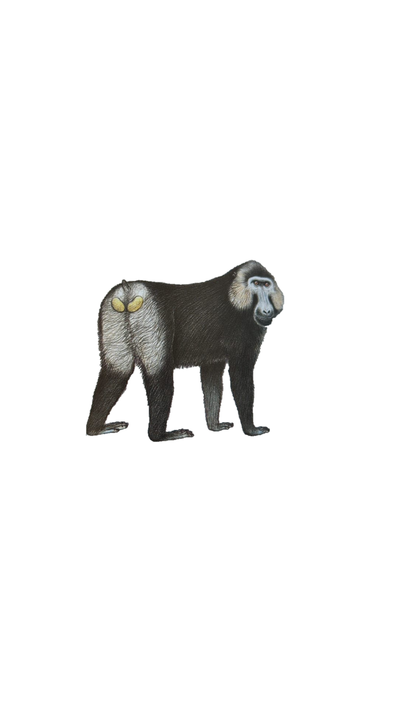
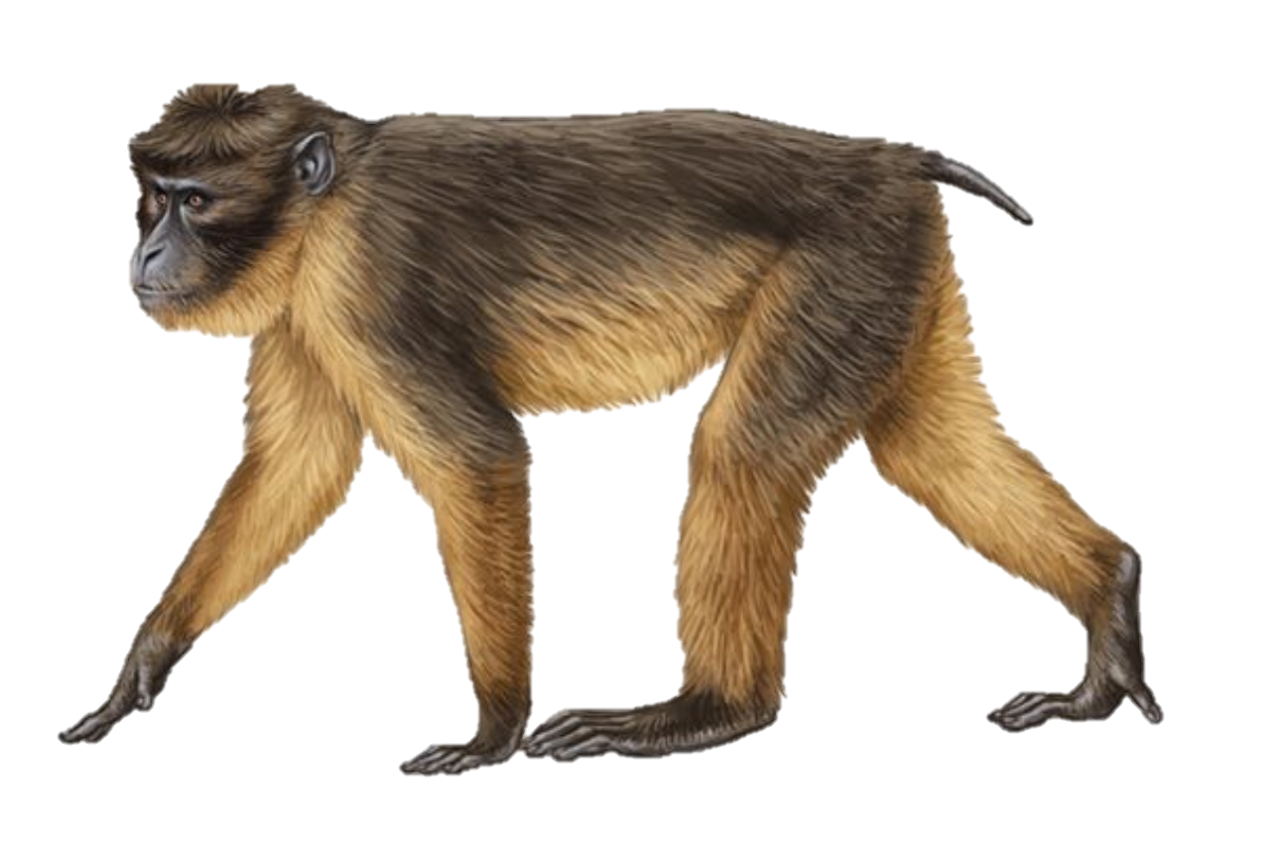
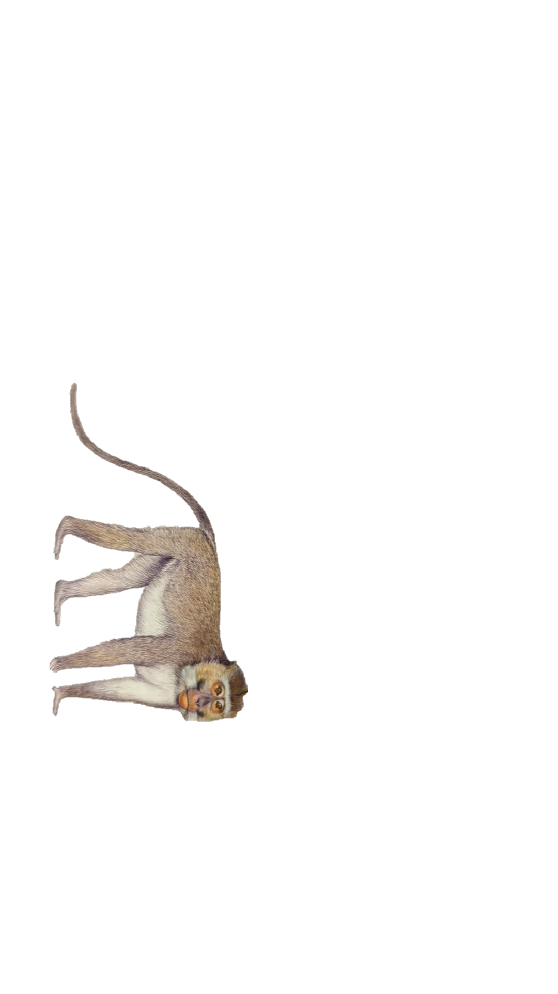
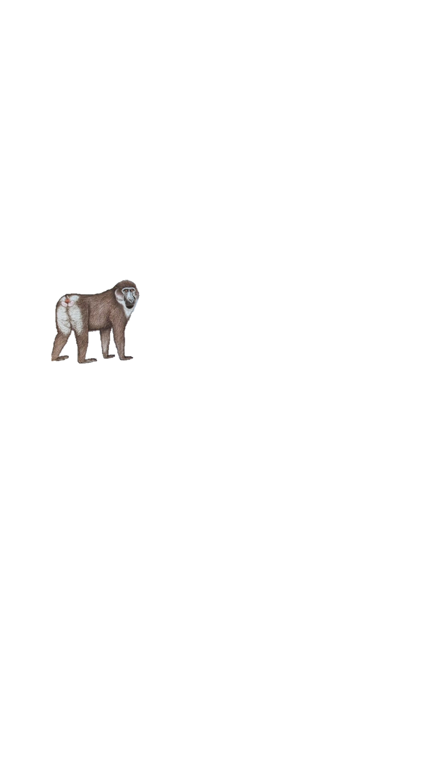
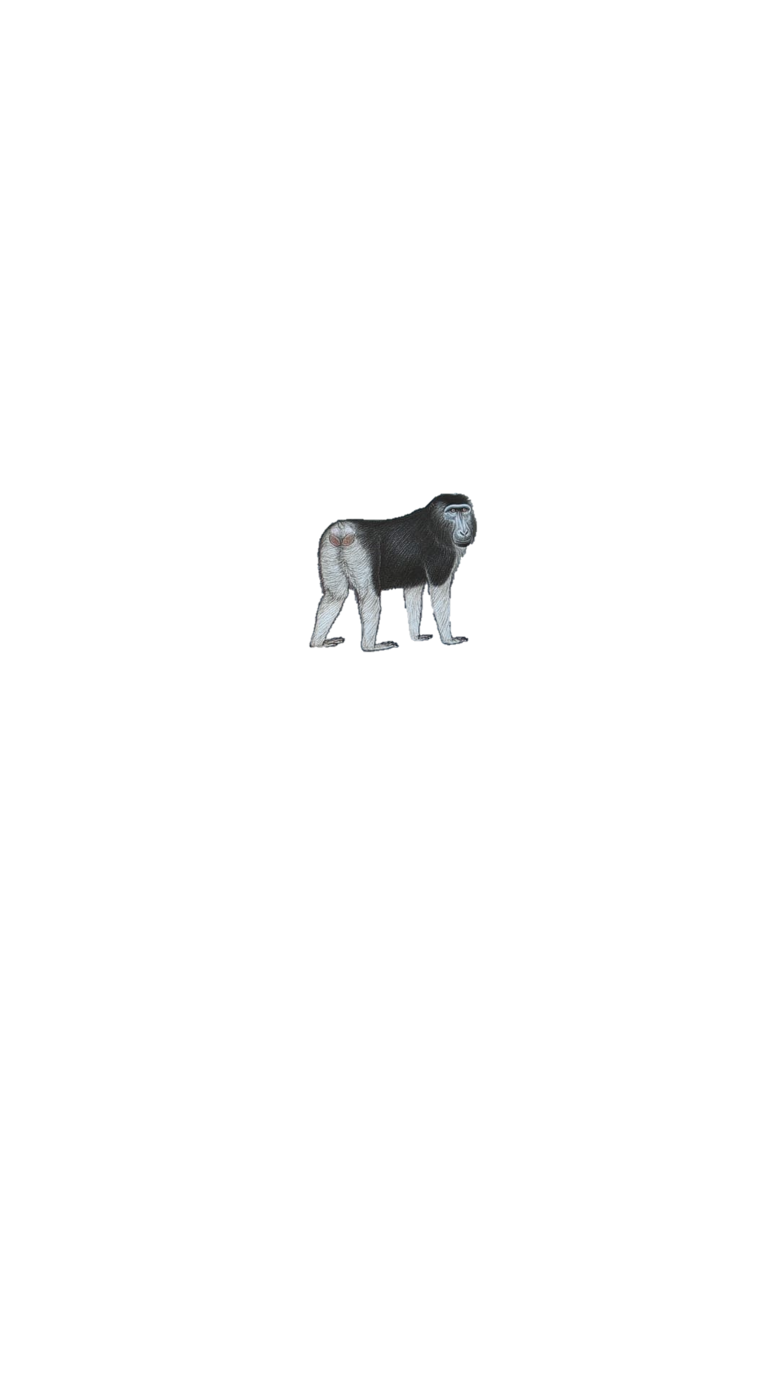

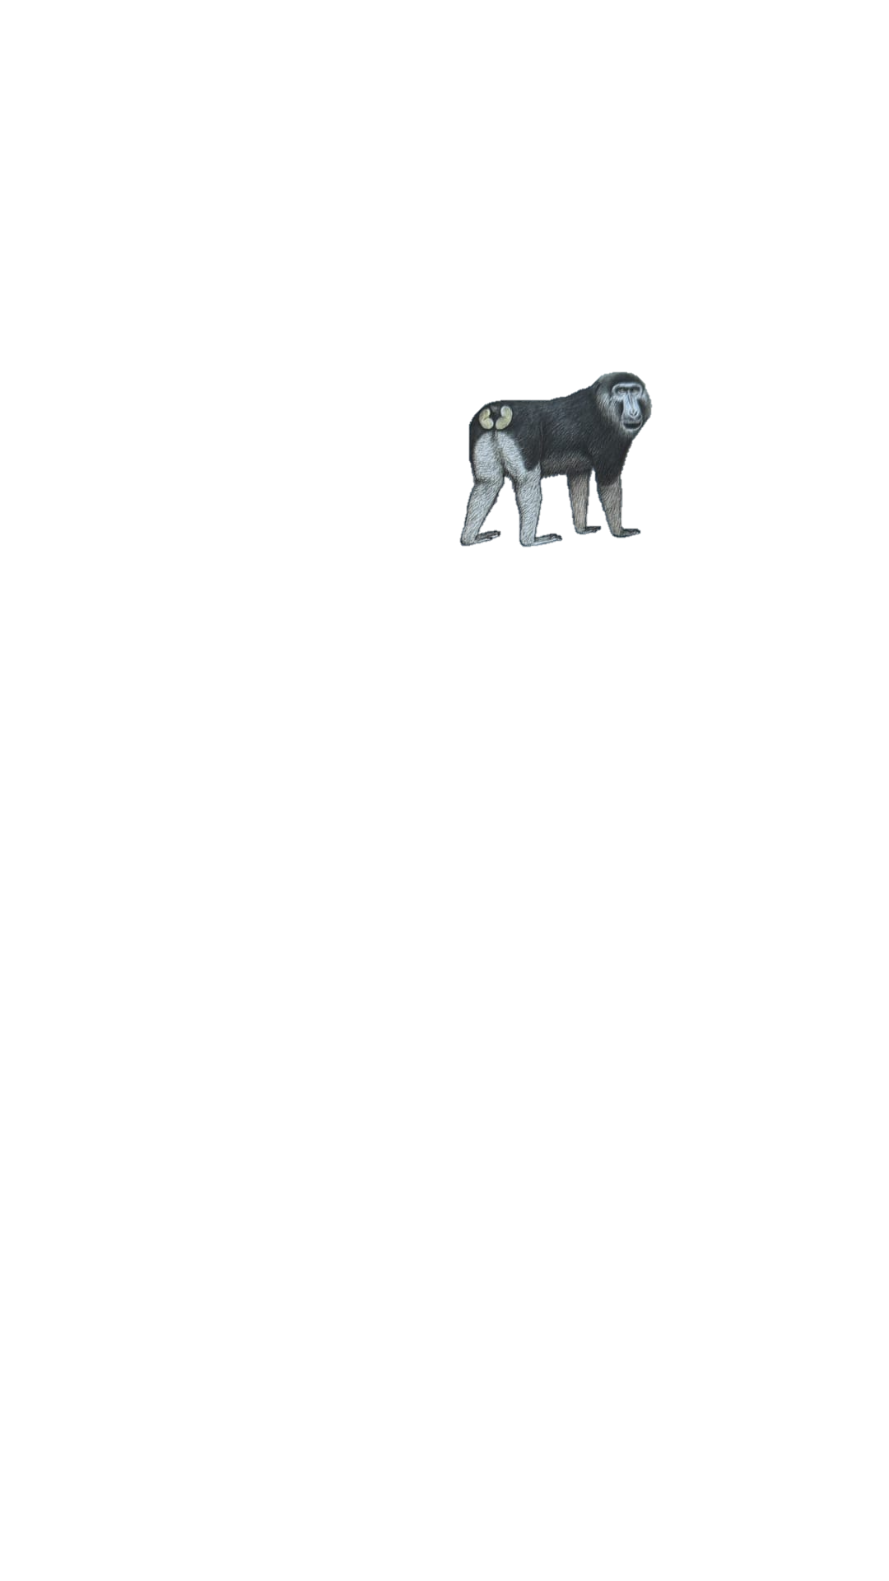
ALL MACAQUE SPECIES
sylvanus group
silenus group
Sulawesi group
sinica group
arctoides group
mulatta group
fascicularis group
Barbary macaque
lion-tailed macaque
N pig-tailed macaque
S pig-tailed macaque
Siberut macaque
Pagai macaque
crested macaque
Gorantolo macaque
Heck’s macaque
tonkeana macaque
moor macaque
booted macaque
toque macaque
bonnet macaque Arunachal macaque Tibetan macaque
Assamese macaque
stump-tailed macaque
rhesus macaque
Taiwanese macaque
Japanese macaque
long-tailed macaque
Roos & Zinner 2015, illustrations from Handbook of the mammals of the world Lynx Editions
8
Notes:
widest distribution of any non-human primate genus --> wide range of habitats & climates (incl anthropogenic environments, remarkable ecological plasticity) from the tropical island of Timor in the south to the northern tip of Honshu Island in Japan and the Atlas Mountains in Morocco
range over large parts of south, east, and southeast Asia. They have even crossed the Wallace line and colonized Sulawesi and Timor

Slide 2
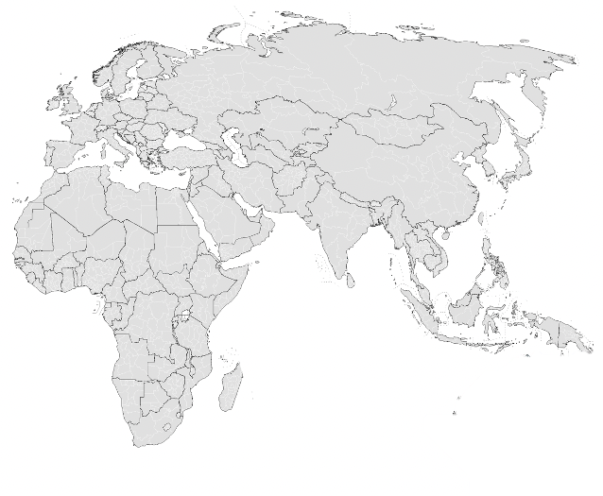
SYLVANUS (BARBARY) SPECIES ONLY
sylvanus group
silenus group
Sulawesi group
sinica group
arctoides group
mulatta group
fascicularis group
Barbary macaque
lion-tailed macaque
N pig-tailed macaque
S pig-tailed macaque
Siberut macaque
Pagai macaque
crested macaque
Gorantolo macaque
Heck’s macaque
tonkeana macaque
moor macaque
booted macaque
toque macaque
bonnet macaque Arunachal macaque Tibetan macaque
Assamese macaque
stump-tailed macaque
rhesus macaque
Formosan macaque
Japanese macaque
long-tailed macaque
Barbary
Roos & Zinner 2015
8
Notes:
widest distribution of any non-human primate genus --> wide range of habitats & climates (incl anthropogenic environments, remarkable ecological plasticity) from the tropical island of Timor in the south to the northern tip of Honshu Island in Japan and the Atlas Mountains in Morocco
range over large parts of south, east, and southeast Asia. They have even crossed the Wallace line and colonized Sulawesi and Timor

Slide 3

SILENUS SPECIES ONLY
sylvanus group
silenus group
Sulawesi group
sinica group
arctoides group
mulatta group
fascicularis group
Barbary macaque
lion-tailed macaque
N pig-tailed macaque
S pig-tailed macaque
Siberut macaque
Pagai macaque
crested macaque
Gorantolo macaque
Heck’s macaque
tonkeana macaque
moor macaque
booted macaque
toque macaque
bonnet macaque Arunachal macaque Tibetan macaque
Assamese macaque
stump-tailed macaque
rhesus macaque
Formosan macaque
Japanese macaque
long-tailed macaque
N pigtailed
lion-tailed
S pigtailed
Siberut
Pagai
Roos & Zinner 2015
8
Notes:
widest distribution of any non-human primate genus --> wide range of habitats & climates (incl anthropogenic environments, remarkable ecological plasticity) from the tropical island of Timor in the south to the northern tip of Honshu Island in Japan and the Atlas Mountains in Morocco
range over large parts of south, east, and southeast Asia. They have even crossed the Wallace line and colonized Sulawesi and Timor

Slide 4
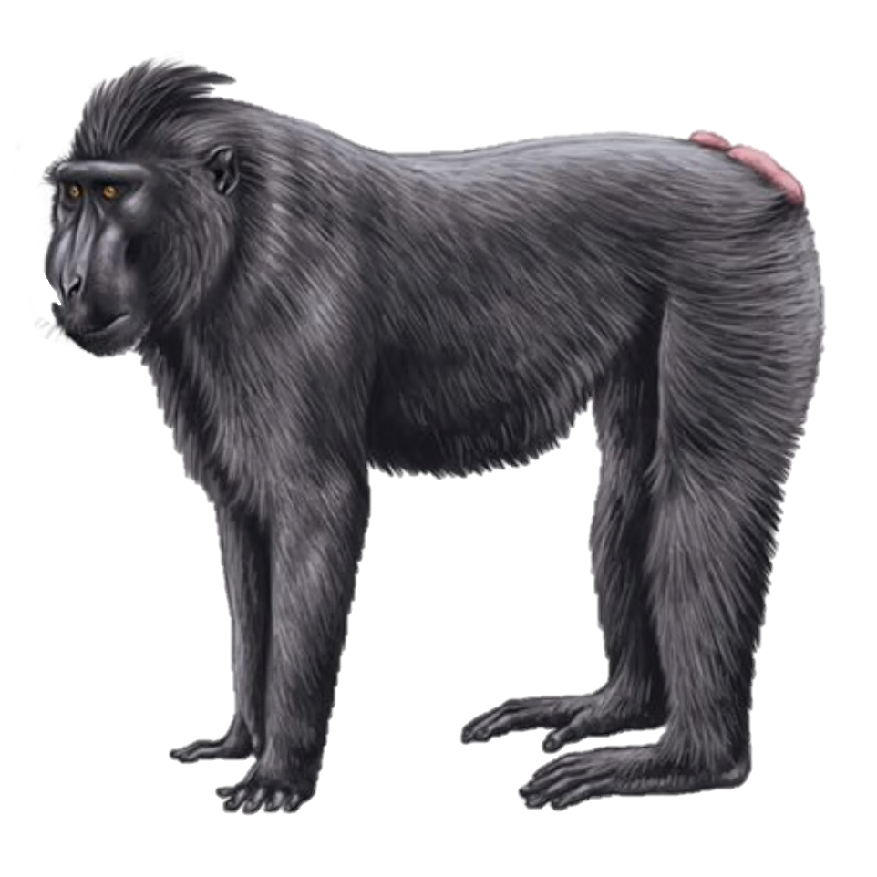
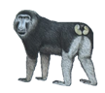
SULAWESI SPECIES ONLY
sylvanus group
silenus group
Sulawesi group
sinica group
arctoides group
mulatta group
fascicularis group
Barbary macaque
lion-tailed macaque
N pig-tailed macaque
S pig-tailed macaque
Siberut macaque
Pagai macaque
crested macaque
Gorantolo macaque
Heck’s macaque
tonkeana macaque
moor macaque
booted macaque
Muna-Buton macaque
toque macaque
bonnet macaque Arunachal macaque Tibetan macaque
Assamese macaque
stump-tailed macaque
rhesus macaque
Formosan macaque
Japanese macaque
long-tailed macaque
crested
Muna-Buton
tonkean
booted
moor
Gorantolo
Heck’s
Roos & Zinner 2015
8
Notes:
widest distribution of any non-human primate genus --> wide range of habitats & climates (incl anthropogenic environments, remarkable ecological plasticity) from the tropical island of Timor in the south to the northern tip of Honshu Island in Japan and the Atlas Mountains in Morocco
range over large parts of south, east, and southeast Asia. They have even crossed the Wallace line and colonized Sulawesi and Timor

Slide 5
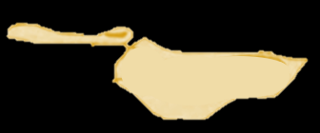
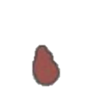
SINICA SPECIES ONLY
sylvanus group
silenus group
Sulawesi group
sinica group
arctoides group
mulatta group
fascicularis group
Barbary macaque
lion-tailed macaque
N pig-tailed macaque
S pig-tailed macaque
Siberut macaque
Pagai macaque
crested macaque
Gorantolo macaque
Heck’s macaque
tonkeana macaque
moor macaque
booted macaque
toque macaque
bonnet macaque Arunachal macaque Tibetan macaque
Assamese macaque
White-cheeked macaque
Sela macaque
stump-tailed macaque
rhesus macaque
Formosan macaque
Japanese macaque
long-tailed macaque
Arunachal
Tibetan
bonnet
Assamese
toque
Roos & Zinner 2015
8
Notes:
widest distribution of any non-human primate genus --> wide range of habitats & climates (incl anthropogenic environments, remarkable ecological plasticity) from the tropical island of Timor in the south to the northern tip of Honshu Island in Japan and the Atlas Mountains in Morocco
range over large parts of south, east, and southeast Asia. They have even crossed the Wallace line and colonized Sulawesi and Timor

Slide 6
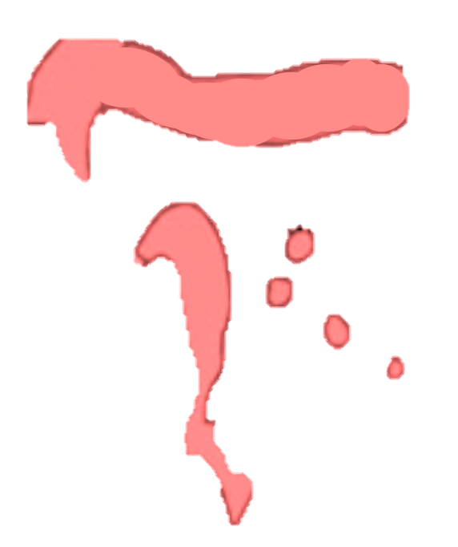
ARCTOIDES SPECIES ONLY
sylvanus group
silenus group
Sulawesi group
sinica group
arctoides group
mulatta group
fascicularis group
Barbary macaque
lion-tailed macaque
N pig-tailed macaque
S pig-tailed macaque
Siberut macaque
Pagai macaque
crested macaque
Gorantolo macaque
Heck’s macaque
tonkeana macaque
moor macaque
booted macaque
toque macaque
bonnet macaque Arunachal macaque Tibetan macaque
Assamese macaque
stump-tailed macaque
rhesus macaque
Formosan macaque
Japanese macaque
long-tailed macaque
stump-tailed
Roos & Zinner 2015
8
Notes:
widest distribution of any non-human primate genus --> wide range of habitats & climates (incl anthropogenic environments, remarkable ecological plasticity) from the tropical island of Timor in the south to the northern tip of Honshu Island in Japan and the Atlas Mountains in Morocco
range over large parts of south, east, and southeast Asia. They have even crossed the Wallace line and colonized Sulawesi and Timor

Slide 7

MULATTA SPECIES ONLY
sylvanus group
silenus group
Sulawesi group
sinica group
arctoides group
mulatta group
fascicularis group
Barbary macaque
lion-tailed macaque
N pig-tailed macaque
S pig-tailed macaque
Siberut macaque
Pagai macaque
crested macaque
Gorantolo macaque
Heck’s macaque
tonkeana macaque
moor macaque
booted macaque
toque macaque
bonnet macaque Arunachal macaque Tibetan macaque
Assamese macaque
stump-tailed macaque
rhesus macaque
Formosan macaque
Japanese macaque
long-tailed macaque
Formosan & Japanese
rhesus
Roos & Zinner 2015
8
Notes:
widest distribution of any non-human primate genus --> wide range of habitats & climates (incl anthropogenic environments, remarkable ecological plasticity) from the tropical island of Timor in the south to the northern tip of Honshu Island in Japan and the Atlas Mountains in Morocco
range over large parts of south, east, and southeast Asia. They have even crossed the Wallace line and colonized Sulawesi and Timor

Slide 8


FASCICULARIS (LONG-TAILED) SPECIES ONLY
sylvanus group
silenus group
Sulawesi group
sinica group
arctoides group
mulatta group
fascicularis group
Barbary macaque
lion-tailed macaque
N pig-tailed macaque
S pig-tailed macaque
Siberut macaque
Pagai macaque
crested macaque
Gorantolo macaque
Heck’s macaque
tonkeana macaque
moor macaque
booted macaque
toque macaque
bonnet macaque Arunachal macaque Tibetan macaque
Assamese macaque
stump-tailed macaque
rhesus macaque
Formosan macaque
Japanese macaque
long-tailed macaque
long-tailed
Roos & Zinner 2015
8
Notes:
widest distribution of any non-human primate genus --> wide range of habitats & climates (incl anthropogenic environments, remarkable ecological plasticity) from the tropical island of Timor in the south to the northern tip of Honshu Island in Japan and the Atlas Mountains in Morocco
range over large parts of south, east, and southeast Asia. They have even crossed the Wallace line and colonized Sulawesi and Timor

